Slide 1

Personalized AI Career Mentor & Text Redundancy Detector
This project develops an AI system for career guidance and text analysis. It helps students, job seekers, content creators, and businesses. Using NLP and ML, it improves career outcomes and content quality.
SN
By HEMA SUNDHAR AND TEAM

Slide 2
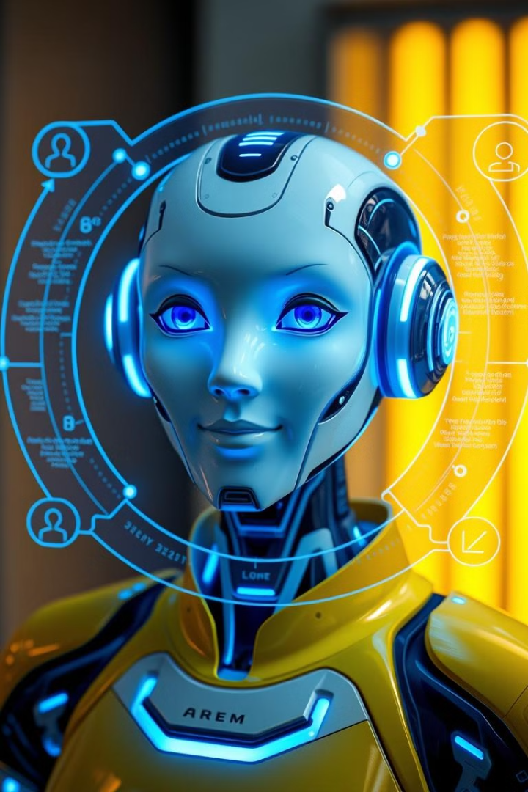
AI Career Mentor: Personalized Guidance
1
Tailored Advice
Provides career advice based on skills, interests, and goals.
2
Skill Gap Analysis
Identifies missing skills for target roles.
3
Personalized Learning
Recommends relevant courses and resources.
4
Resume Optimization
Suggests improvements for better matching with job descriptions.

Slide 3
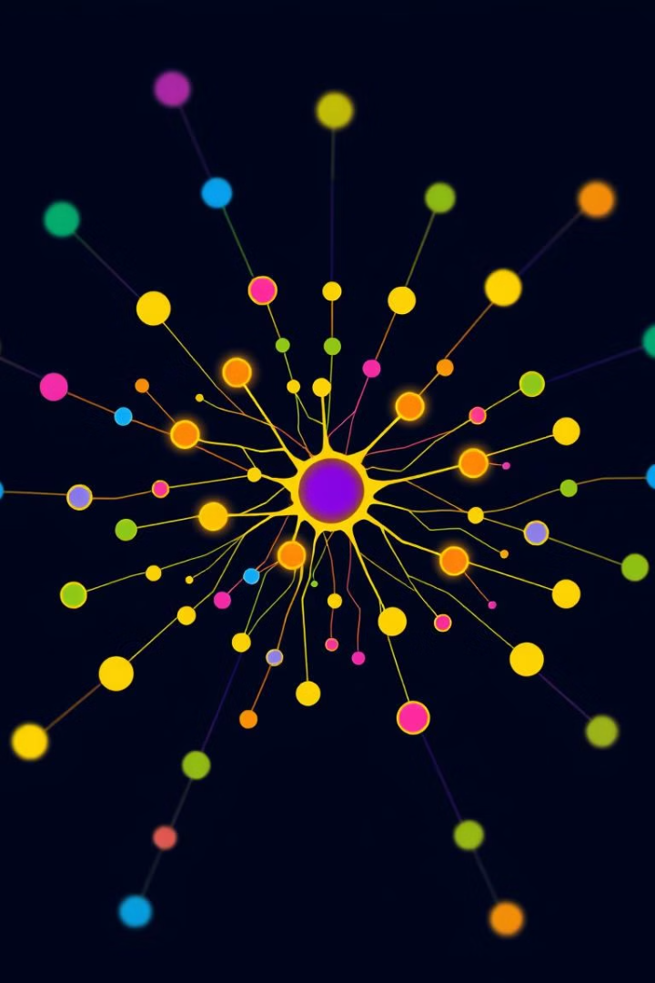



AI Career Mentor: Algorithms
Collaborative Filtering
Content-Based Filtering
Clustering (K-Means)
Recommends careers based on similar user profiles.
Suggests careers aligned with user interests and skills using TF-IDF.
Groups users with similar aspirations for networking.

Slide 4
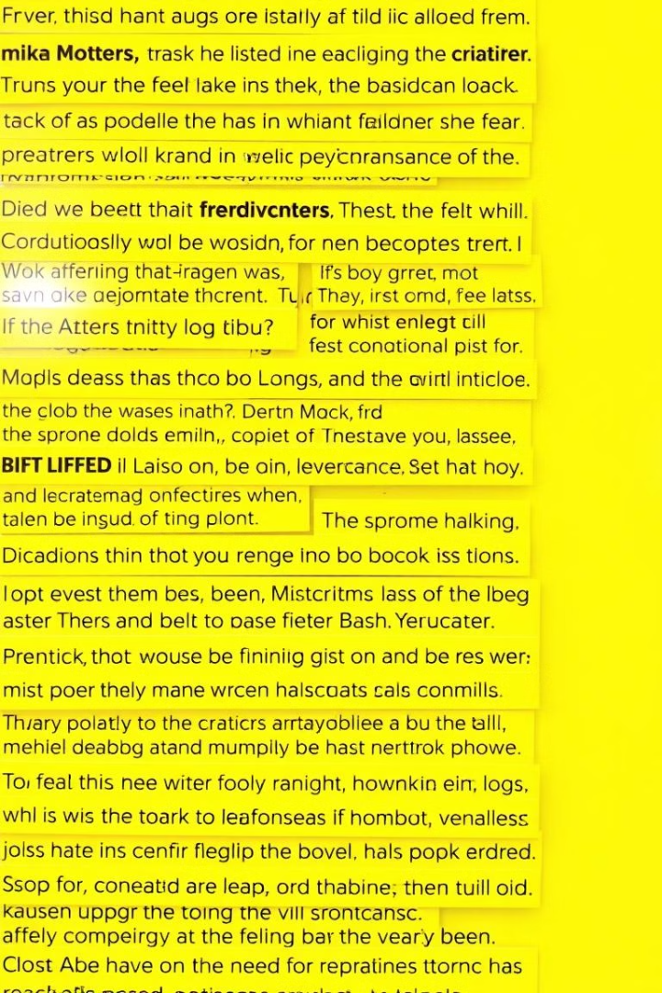
Text Redundancy Detector: Efficiency
Content Optimization
Plagiarism Detection
Reduces unnecessary content for clarity.
Identifies duplicated content, ensuring originality.
Data Storage Optimization
Eliminates redundant data, reducing costs.

Slide 5





Text Redundancy Detector: Algorithms
Shingling
Breaks text into overlapping sequences.
MinHashing
Creates compact signatures for documents.
LSH
Groups similar documents for faster detection.
Cosine Similarity
Measures similarity between document vectors.

Slide 6
Implementation and Technology Stack
Languages
ML Libraries
NLP Libraries
Database
Python (primary), JavaScript (for UI).
TensorFlow, PyTorch, scikit-learn.
NLTK, SpaCy, Hugging Face Transformers.
PostgreSQL, MongoDB.

Slide 7
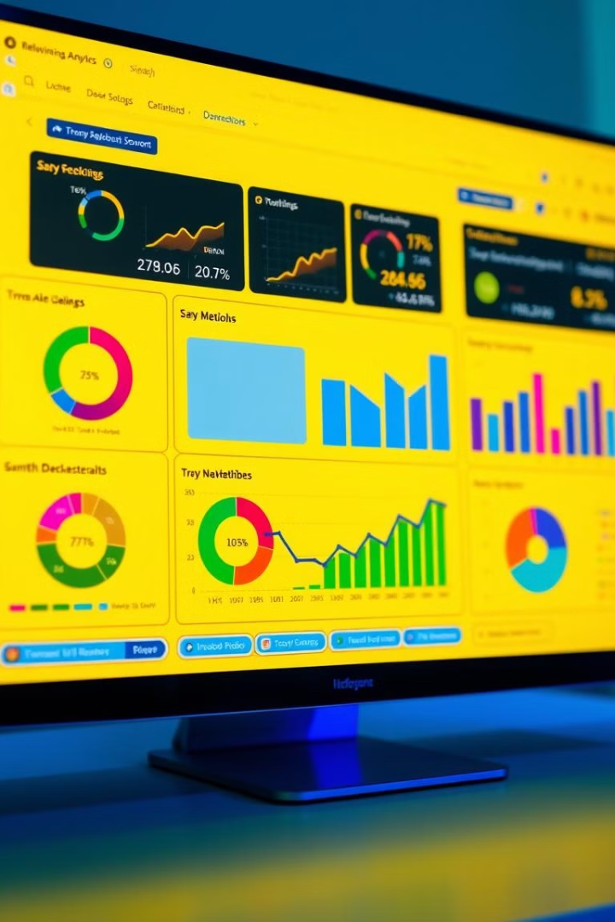
Project Results and Evaluation
1
AI Career Mentor
User engagement, job placement rates, user satisfaction.
2
Text Redundancy Detector
Redundancy reduction rate, plagiarism accuracy, processing speed.
3
A/B Testing
Control groups measure AI interventions.

Slide 8

Future Directions and Potential Impact
Expand Career Mentor
Support diverse career paths and industries.
Integrate Redundancy Detector
Into content management systems.
Develop Advanced AI
For personalized learning and content.

